Slide 1
Medical Imaging Information Session 2021
Essential Information for applicants to the Columbus State Medical Imaging Associate Degree program starting Autumn Semester 2021

Slide 2
Application Deadline
By March 1, 2021, the following must be completed and submitted:
Medical Imaging Application Form | Include 2 paragraph statement of interest Include completed Admissions Worksheet
Transcripts | From high school From any previous college experience
Observation hours | Documentation of 16 hours observing radiography procedures in a hospital medical imaging department
Testing | Aleks (Math) Placement test Accuplacer Placement test HESI A2 Exam
Course readiness | Must have taken or be eligible to take BIOL 2300 and MATH 1148 by Autumn 2021

Slide 3
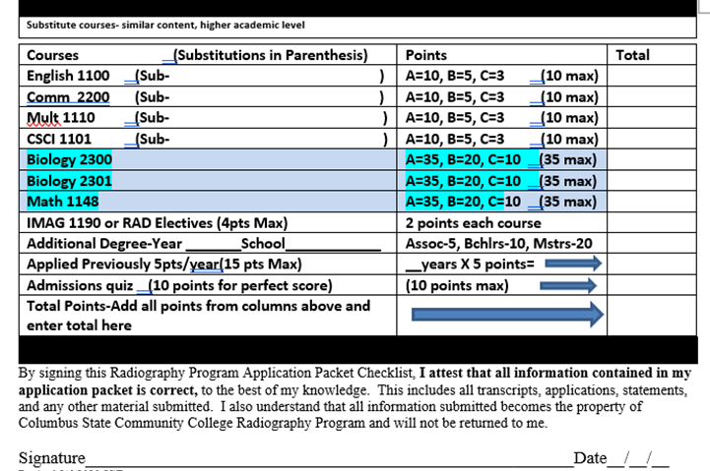

Slide 4
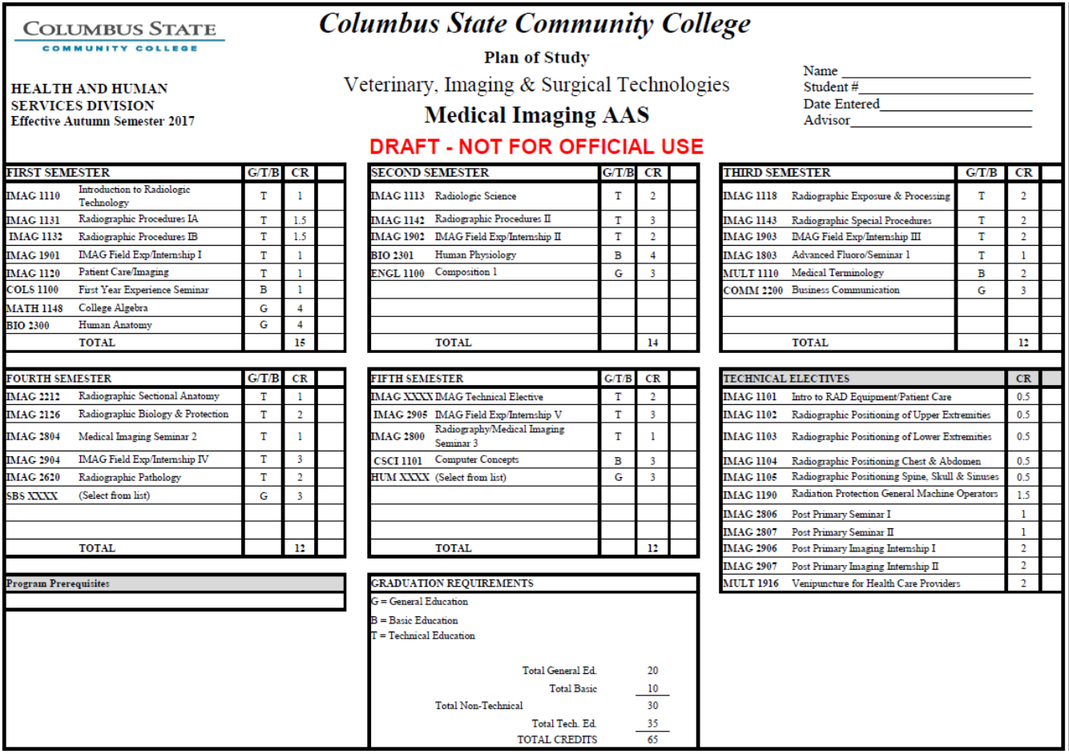

Slide 5
Other Program Entry Requirements
If accepted into the program, the following must be completed prior to Autumn Semester 2021:
CPR Certification | Basic Life Support (BLS) CPR for Healthcare Workers certification is required for final program admission and for program continuance.
Criminal Background Check | Any felony conviction or several misdemeanor convictions may disqualify from final program admission or program continuance.
Drug Screen | Any illegal drug use may disqualify from final program admission.
Physical Exam | Health Records Office requirements must be met to include initial physical examination, immunization records, and tuberculosis screening. Ongoing requirements include annual tuberculosis screening and seasonal flu immunization. See Columbus State Health Records website.

Slide 6
Program Continuation Requirements
Once accepted, the following are required to continue in the program.
Academic progress | Grade of C or higher in each technical course Total GPA of 2.0 or higher
Criminal Background Check | If required by clinical site
Drug Screen | As required by clinical site.
Physical Health | Meet Health Records office requirements to include immunizations such as seasonal flu vaccination and annual tuberculosis screening. Maintain ability to perform essential skills.
CPR | Must maintain current CPR BLS certification.

Slide 7
Medical Imaging Profession
The American Registry of Radiologic Technologists allows 6 Primary Eligibility pathways. The Columbus State Medical Imaging Associate Degree program offers the Radiography Primary Eligibility Pathway

Slide 8
Medical Imaging Profession
Graduates of the Medical Imaging Associate Degree program may continue their education through a PostPrimary pathway. Columbus State currently offers courses toward Computed Tomography and Magnetic Resonance Imaging.

Slide 9
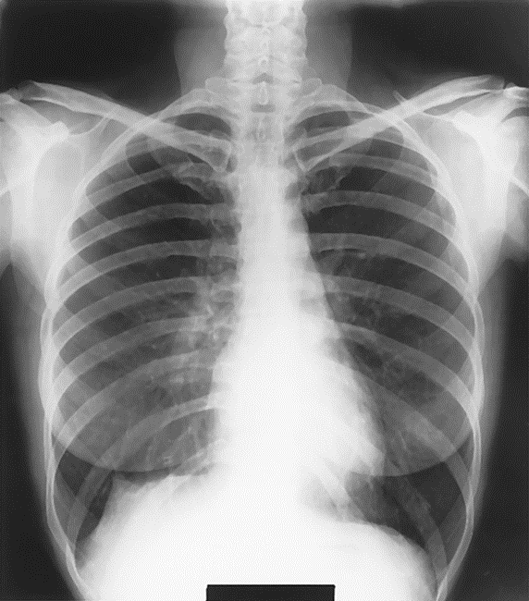
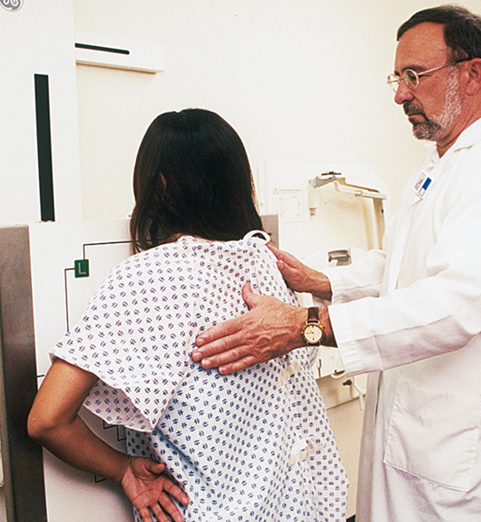
Radiography
Most radiologic technologists enter the profession as radiographers. In this role, you’ll capture images of patients’ internal organs, soft tissues, and bones using X-ray equipment. You also might assist radiologists with a range of procedures, such as fluoroscopic imaging or gastrointestinal exams that require the use of contrast media.

Slide 10
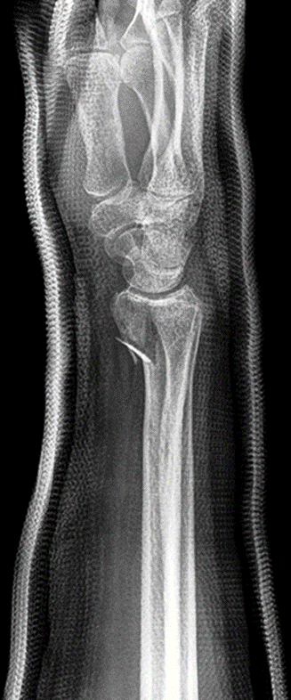
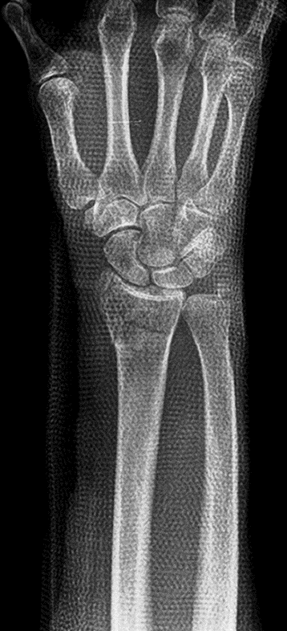
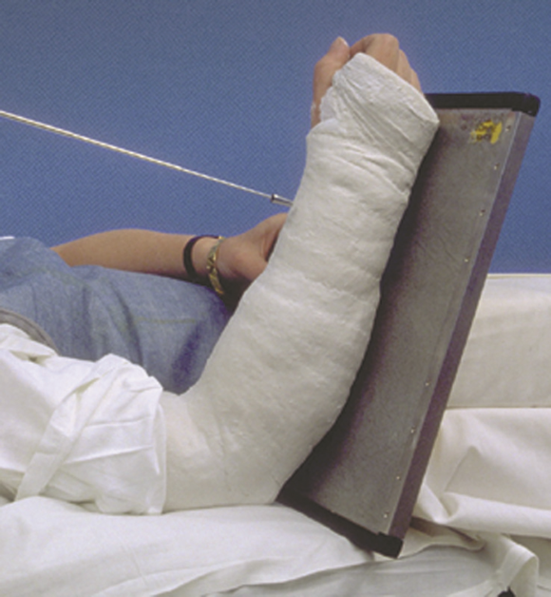
Radiography
Radiographic images are used to diagnose illness or injury. They are also used to evaluate the effectiveness of treatment and follow up.

Slide 11
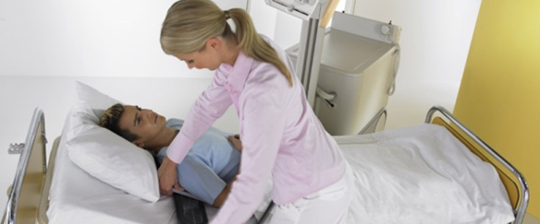
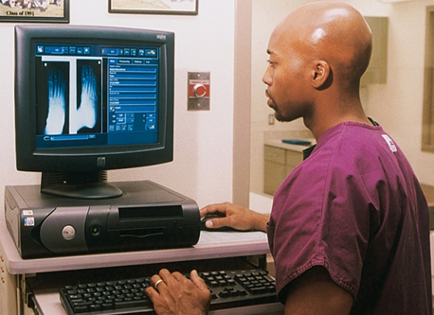
Radiographers work with people and technology in a variety of settings.

Slide 12
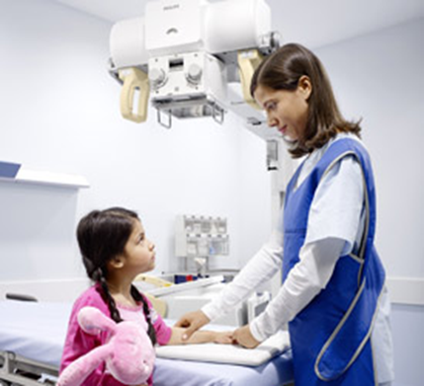
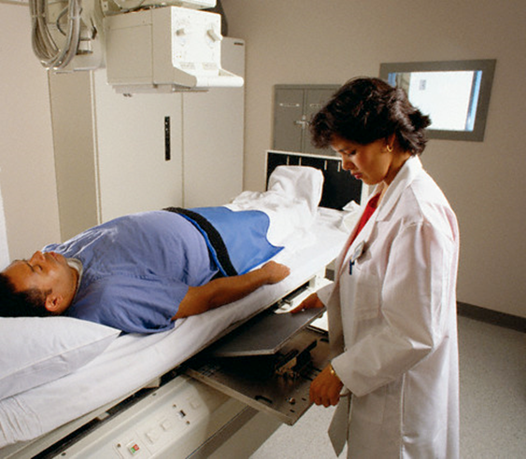
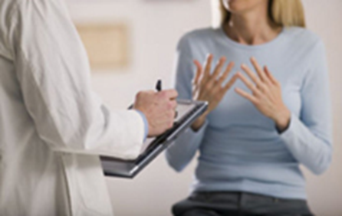
Desired Qualities
Communication skills
Customer service
Critical thinking
Technical ability
Positive attitude
Adaptability

Slide 13
Medical Imaging Associate Degree Curriculum
5 consecutive Semesters starting each Autumn
Autumn
Semester
MWF
TTH
Spring Semester
MWF
TTH
Summer Semester
MF
WThF
Autumn
Semester
Spring Semester
Class
TTh
TTh
Clinical
MWF
MWF

Slide 14
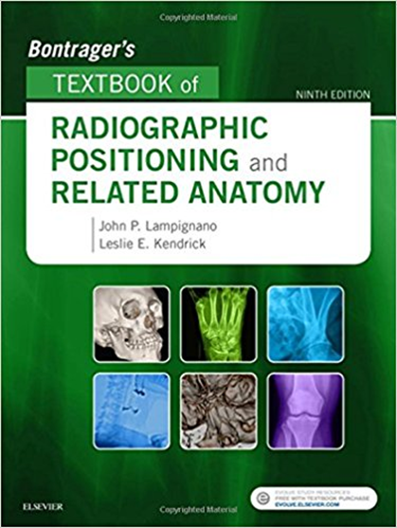
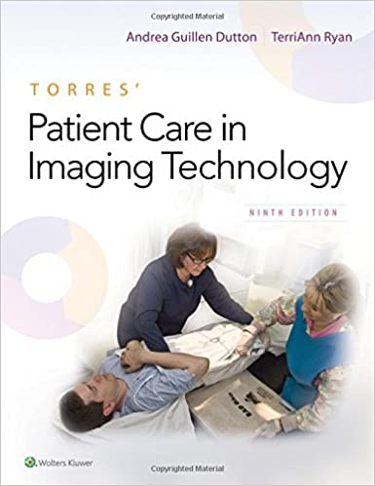
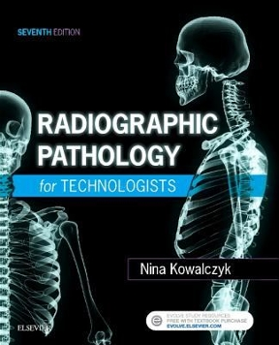
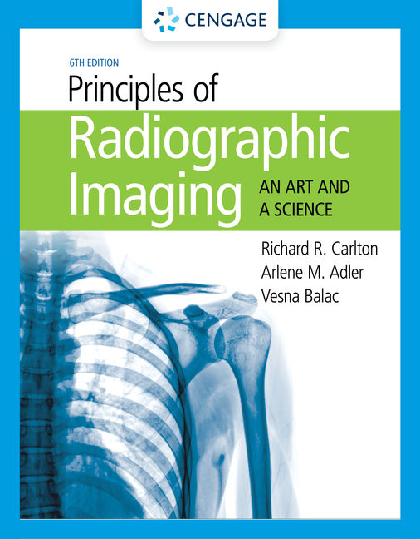
Medical Imaging Associate Degree Curriculum
Classes:
Patient Care in Medical Imaging
Radiographic Procedures
Radiation Physics
Equipment Operation
Pathology for Imaging Technologists
Radiation Biology and Protection

Slide 15
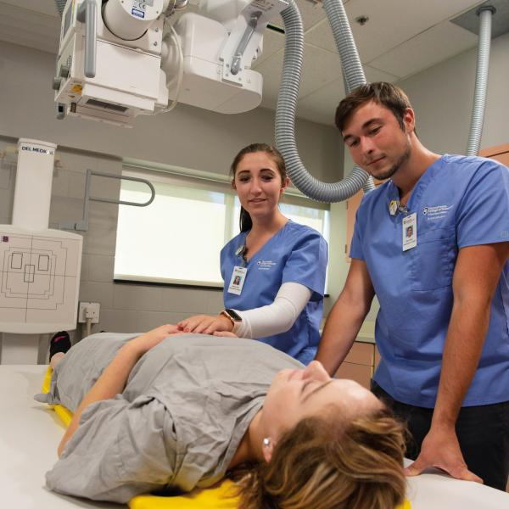
Medical Imaging Associate Degree Curriculum
Medical Imaging Labs:
Practice procedure setup without making an x-ray exposure.
Students take turn serving as patient.
**Currently with COVID precautions:
Lab sizes are limited.
Handwashing enforced.
Students wear gloves and masks.
Students with symptoms may not attend.

Slide 16
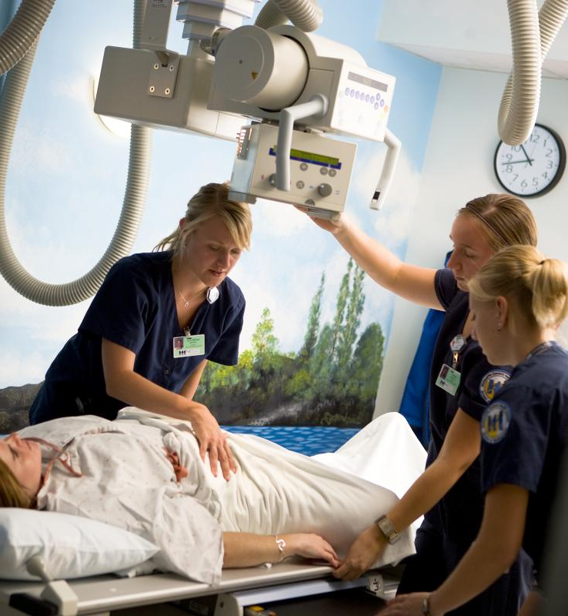
Medical Imaging Associate Degree Curriculum
Clinical:
Interact with patients and staff.
Practice and perform clinical skills to demonstrate competency.
A 21 month job interview.
Like a job – clock in and out.
Hours are usually between 7:00 AM and 4:30 PM (most rotations are 7:00 AM – 3:30 PM)
Trauma rotations include evening and midnight shift rotations – the last 3 semesters.

Slide 17
Medical Imaging Associate Degree Curriculum
Clinical:
Participate in medical imaging procedures
In the Radiology Department
At the patient’s bedside
In surgery
In the Emergency Department

Slide 18
Clinical Sites
Primary Sites
Riverside Methodist Hospitals (6)
Grant Medical Center (6)
Doctors Hospital (4)
Dublin Methodist Hospital (2)
Berger Hospital Circleville (2)
Memorial Hospital Marysville (2)
Grady Hospital Delaware (1)
Rotation Sites
Chalmers Wylie Veterans Administration Clinic
Nationwide Children’s Hospital
OhioHealth Pickerington, Grove City and Gahanna

Slide 19
16 Observation Hours Notes:
Documentation - use forms provided. The clinical site will fill out the form and return to us.
Schedule in advance – TB screening is required prior to observation at most sites. Schedule your observation hours through the radiology department clinical instructor or manager (phone numbers listed in Student Handbook).
Appropriate dress – You will be shadowing staff in patient care areas. Business casual dress is expected. (i.e. no shorts, jeans, cutoffs, sandals, sweats, T-shirts, tennis shoes, etc.) If you are dressed inappropriately to be seen by patients, expect to be sent home.

Slide 20
16 Observation Hours Notes:
Cellphone use during observation is prohibited. If you get your cellphone out, expect to be sent home.
Confidentiality – You will be asked to sign a Confidential Information statement. You will see and hear information that is confidential and may not be shared outside the clinical setting. You need to agree to these conditions. Additionally – no photography, video, or audio recording allowed at the clinical site.
Participation – You are expected to follow and observe staff technologists performing patient exams. (i.e. not sitting, snoozing, or reading).

Slide 21
From the Medical Imaging Student Handbook
**You are responsible to review the entire Student Handbook which is available online.
Health Insurance – students are required to carry personal health insurance while in the program.
Dress Code at clinical site - Navy scrub pants, white scrub top, white shoes, ID badge, radiation monitor. No visible tattoos, limited piercing (ears only), and natural hair color.
Cellphone Use – Prohibited during clinical except at lunch break. Never allowed for recoding images or audio at clinical.

Slide 22
From the Medical Imaging Student Handbook
General and Fire Safety - Policies strictly enforced to include fire hazard, fall hazard due to spills, etc.
Infection Control – Practices such as handwashing, wearing protective equipment, must be strictly observed.
Infection/Injury Risk – Even with protective apparel and safe practices, there is a risk of exposure to infectious disease and risk of injury in general. Student agrees to assume this risk and carry personal medical insurance.

Slide 23
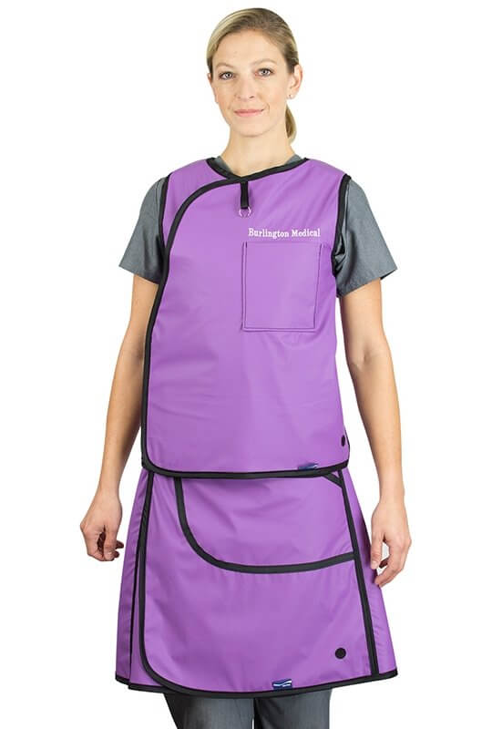
From the Medical Imaging Student Handbook
Radiation Exposure Risk – Student radiation exposures are kept to a minimum by following radiation protection practices and policies. Still there will be some student x-radiation exposure during this program which will be monitored and reported as appropriate. Student agrees to assume this risk.

Slide 24
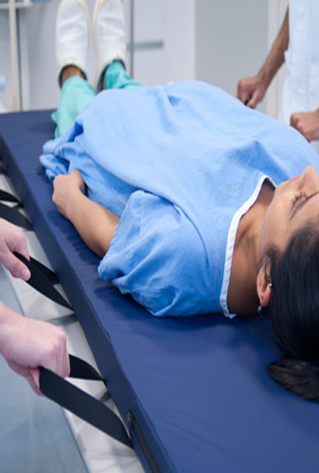
From the Medical Imaging Student Handbook
Essential Skills – see handbook for entire list
Physical - walking, standing, running, bending, lifting, reaching, hand/eye coordination, ascend/descend stairs, enter/exit narrow protective barrier entry
Assist lifting patients and/or equipment using upper body strength
Manual dexterity to perform CPR, draw medication, perform venipuncture
Stamina to wear 10-15 lb protective apron during radiologic procedures for several hours at a time.
Must be able to participate as a patient for laboratory practice.

Slide 25
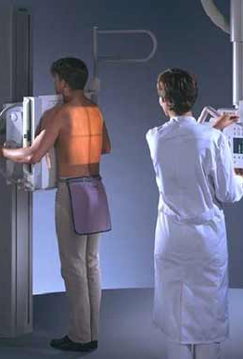
From the Medical Imaging Student Handbook
Essential Skills – see handbook for entire list
Sensory - see patient/staff distance of 6-10 feet under dim light condition.
Observe patient movement, change in condition such as skin color. Observer color monitor lights
Hear and comprehend patient speech with background noise at 6-10 feet. Hear and respond to information broadcast over PA system.
Adaptable – able to work in stressful situations while maintaining composure; adapt to unpleasant situations, smells, sights.

Slide 26
Program Personnel
Program Coordinator Jerry Tyree, MS, RT jtyree@cscc.edu
Clinical Coordinator Jeffrey Rowe, MS, RT jrowe10@cscc.edu
Clinical Specialist Megan Schwartz, BS, RT mschwartz5@cscc.edu
Department Chair Terrence Brown, PhD tbrown70@cscc.edu
Program Coordinator Kelly Fannin kfannin@cscc.edu

Slide 27
Important reference sites
Columbus State Medical Imaging Program
Admissions
https://www.cscc.edu/academics/departments/medical-imaging/admissions.shtml
Admissions Worksheet – note –from last year
https://www.cscc.edu/academics/departments/medical-imaging/pdfs/IMAG%20Admissions%20Worksheet.pdf
Student Handbook – note – from 2018
https://www.cscc.edu/academics/departments/medical-imaging/pdfs/IMAG-Student-Handbook.pdf

Slide 28
Important reference sites
Columbus State Medical Imaging Program
Health and Human Services Advising
https://www.cscc.edu/services/advising/hhs-advising.shtml

Slide 29
Important reference sites
Columbus State Catalog
Medical Imaging Associate Degree Curriculum
https://catalog.cscc.edu/programs/Medical%20Imaging%20AAS

Slide 30
Important reference sites
Columbus State Health Records
https://www.cscc.edu/services/health-records/index.shtml
Scroll down to Health Records Forms By Program – Medical Imaging is grouped with Nursing

Slide 31
Important reference sites
American Registry of Radiologic Technologists
Credentials and pathways:
https://www.arrt.org/pages/earn-arrt-credentials/requirements
Request for ethics review:
https://www.arrt.org/pages/earn-arrt-credentials/initial-requirements/ethics/ethics-review-preapplication
ARRT ethics requirements:
https://www.arrt.org/pages/earn-arrt-credentials/initial-requirements/ethics/ethics-requirements

Slide 32
Important reference sites
American Society of Radiologic Technologists
Career Information
https://www.asrt.org/main/career-center/careers-in-radiologic-technology

Slide 33
Important reference sites
Useful Youtube videos
What is Radiography?
https://www.youtube.com/watch?v=VJmu_TrRGRY&ab_channel=CloverLearning
A Radiologic Technology Program
https://www.youtube.com/watch?v=TvIg5pl4njM&ab_channel=MontgomeryCollege

