Slide 1
MEDICAL ASSISTING TECHNOLOGY (MAT)
Tonya G. Redden, BS HCM, MAT ATS, CMA(AAMA)
Program Coordinator
MAT@cscc.edu
Union Hall 326
(614) 287-3638

Slide 2
Information Sessions
All prospective MAT students are required to attend an information session or complete the online quiz prior to applying to the MAT program.
May 02, 2024 @ 3:30 PM
June 03, 2024 @ 10 AM
June 10, 2024 @ 10 AM
June 17, 2024 @ 10 AM
June 24, 2024 @ 10 AM
July 08, 2024 @ 10 AM
July 15, 2024 @ 10 AM
Location: Union Hall, Room 329

Slide 3
What is a medical assistant?
Medical Assistants are multiskilled health professionals specifically educated to work in a variety of healthcare settings performing clinical and administrative duties. The practice of Medical Assisting necessitates mastery of a complex body of knowledge and specialized skills requiring both formal education and practical experience that serve as standards for entry into the profession.
CAAHEP, Standard & Guidelines for the
Accreditation of Educational Programs in
Medical Assisting, April 2022

Slide 4
you may be wondering “IS MEDICAL ASSISTING FOR ME?”
A career as a Medical Assistant provides:
Opportunity to build relationships with patients (people-oriented profession)
Interesting and meaningful work
A high-tech and exciting career
Opportunity to be a respected member of the healthcare professions
Ability to make a difference in people’s lives
A solid career path in healthcare

Slide 5
Where do Medical Assistants Work?
Directly with a physician in an office environment
Ambulatory care settings such as clinics and urgent care facilities
In specialty offices
In hospitals

Slide 6
Medical Assistants’ clinical responsibilities
EKGs, Holter Monitors, Injections
Patient Education & Triage
Pulmonary Function Testing
Vital Signs, Height and Weight
Assisting with Pap & Pelvic Examinations
Assisting with Sigmoidoscopy
Phlebotomy
Medication Reconciliations
Assisting with Minor Surgeries
CLIA-Waived Lab Tests
Scheduling Outpatient Testing
Vision & Hearing Screenings
Wound Care & Suture Removal

Slide 7
Medical Assistants’ Administrative responsibilities
Maintaining Medical Records
Bookkeeping
Scheduling Appointments
Maintaining Supplies
Filing Insurance Forms/Claims
Processing Payroll
Sorting And Filing Mail
Electronic Medical Records (EMR)
ICD-10 & CPT Coding Procedures
Arranging Patient Hospitalization and Surgeries
Telephone Management

Slide 8
JOB MARKET
Employment of Medical Assistants is expected to grow 29 percent from 2016 to 2026
One of the fastest growing occupations in the country
The median annual wage for medical assistants is $40,700 in according to the U.S. Bureau of Labor Statistics. These are starting wages.
Salary varies with certification and/or GMXO
Central Ohio starting hourly pay as high as $23/hr. due to shortage of MAs.
Positive
career
path!

Slide 9
Program Goal
The goal of the Medical Assisting Program (Certificate and ATS Degree) at CSCC is to prepare students as professional and competent entry-level medical assistants in the cognitive (knowledge), psychomotor (skills), and affective (behavior) learning domains.

Slide 10
MAT Accreditation
The CSCC Medical Assisting certificate program is accredited by the Commission on Accreditation of Allied Health Education Programs (CAAHEP) upon the recommendation of the Medical Assisting Education Review Board (MAERB).

Slide 11
Historical Overview
CSCC was awarded approval from the Ohio Board of Regents to implement a Medical Assisting (MAT) program in 1996. The college began accepting candidates for the associates degree June 1996.
In April 1999, the CSCC MAT program received accreditation from CAAHEP, upon recommendation of MAERB as an associate degree program.
In 2006 the program was converted to a one-plus-one program in which students can follow the plan of study for the medical assisting certificate program and then choose to continue at CSCC to achieve the medical assisting ATS degree.

Slide 12
Certificate or Degree
Option 1: Certificate in Medical Assisting
Option 2: Certificate and Associate of Technical Studies Degree (ATS)
All students complete the Medical Assisting Certificate Program during the first three semesters. Those who choose to may then pursue an ATS degree in Medical Assisting Technology after earning their certificate.

Slide 13
The Medical Assisting Program:
Is a sequential program in which a plan of study is followed as it is written
Is a fulltime program: Monday through Thursday
Is a day-shift course of study
Requires a background check and drug screen
Starts fall semester
Is located on the Columbus campus
Requires completion of 37 credit hours for the Medical Assisting Certificate Program
Requires completion of 62 credit hours for the ATS degree, Medical Assisting Technology

Slide 14
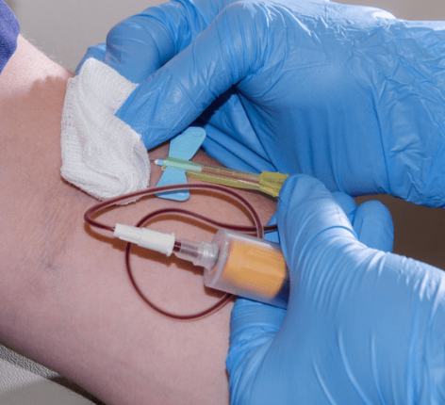
Competency-Based Outcomes
Upon completion of the Certificate Program in Medical Assisting, the graduate will be able to:
Perform and document the patient interview, health history, and medication reconciliation
Prepare the patient for examination and assist provider with patient instruction in follow-up care, as well as provide education in health maintenance and disease prevention
Evaluate and demonstrate mutually OSHA and CLIA standards by performing:
Infection control techniques in compliance with the Standard Precautions and guidelines set forth by the OSHA and CDC, and
Various waived testing in compliance set forth by CLIA
Demonstrate all administrative procedures performed in the medical office including EMR, while observing HIPAA laws, medicolegal and ethical responsibilities
Demonstrate successful completion of all clinical and administrative competencies
Conduct themselves in a professional manner to meet work force demands

Slide 15
Degree Requirements
Basic Related and General Education courses may be taken prior to being admitted
to the Medical Assisting program, or they may be taken with MAT courses as outlined on the official plan of study. Completion of basic related and general education courses are not required prior to application.
General Education & Basic Related Degree Requirements
MEDICAL ASSISTING CERTIFICATE
MEDICAL ASSISTING ATS DEGREE
BIO 1121—Anatomy & Physiology I
BIO 1122—Anatomy & Physiology II
MULT 1110—Medical Terminology
ENGL 1100—Composition I
HIMT 1274—Intro to Medical Coding
COLS 1100—1st Year Experience
BIO 1121—Anatomy & Physiology I
BIO 1122—Anatomy & Physiology II
MULT 1110—Medical Terminology
ENGL 1100—Composition I
HIMT 1274—Intro to Medical Coding
BMGT 2200—Management and Organizational Behavior
HIMT 1121—Advanced Medical Terminology
BMGT 1102—Interpersonal Skills
One Arts/Humanities from approved list*
MATH 1104—Mathematical Concepts for Business ORSTAT 1350—Elementary Statistics
PSY 1100—Intro to Psychology
* Select ONE Arts/Humanities: ARCH 2100, HART 1201, HART 1202,
HIST 1111, HIST 1112, HIST 1151, HIST 1152, HIST 1181, HIST 1182,
HIST 2223, HIST 2224, HUM 1100, HUM 1270, MUS 1251, PHIL 1101,
PHIL 1130

Slide 16
Program PREREQUISITES
High school transcript or GED on file
Reading: Placement of “No Reading Courses Required”
English: Placement into ENGL 1100
Math: Placement into MATH 1104 or STAT 1350
Completion of MULT 1130 with a C or better, or the following:
Current Healthcare Provider CPR with AED Certification, AND
Current American Red Cross Certification in First Aid
Both through the American Hearth Association or Red Cross
GPA 2.0 or higher

Slide 17
Health & Human Services Advisors
All prospective MAT candidates are required to meet with an HHS advisor before entering the Medical Assisting program.
Available in-person, by phone, or by email.
To schedule an appointment, call (614) 287-2779 or email them at hhsadvising@cscc.edu.
Drop n Hours:
Monday, Tuesday, Thursday: 11am – 2pm
Wednesday: 11am – 2pm & 4pm – 6:30pm
Friday (virtual chat only): 11am – 2pm
This Photo by Unknown Author is licensed under CC BY

Slide 18
Additional Prerequisites
Complete a medical health record
01
Complete a background check
02
Complete a drug screen
03

Slide 19
Medical Assistant CREDENTIALING
Once students obtain their MAT certificates, they are eligible to sit for the following examinations:
CMA by the American Association of Medical Assistants (AAMA) which is offered year round
RMA by the American Medical Technologist (AMT) Specialist (CMAS)
RMA by the American Registry of Medical Assistants provided they attend a CAAHEP accredited school such as CSCC
CCMA by National Healthcareer Association Certification

Slide 20
Transfer of Credit
To receive transfer credit for a course taken at another educational institution, a student must first, be accepted to Columbus State Community College, and second, submit an official transcript of the course work taken at another college. All official transcripts are evaluated by the Credit Coordinator of the Office of Student Records and Registration for transcript credit. If credit is granted, a “K” will appear on the transcript as the grade for the course. Transcript credit is not used in determining the grade point average.

Slide 21
Examination and Proficiency Credit
A student may, upon the department chairperson’s approval of the student’s petition, be permitted to take a proficiency examination for credit. Permission is given only in cases when it is evident that previous experience or study warrants.
A $50 non-refundable fee will be charged for each proficiency examination. Examination/proficiency credit does not apply to meeting residency credit hour requirements.
Proficiency tests are NOT available for all technical courses. Check with the Program Coordinator for further information.
A student is permitted to take a proficiency test ONCE per course, and if he/she receives a score of 80% or higher, he/she has satisfactorily completed the course. The course grade will read “X” on the transcript and will not be used in determining the grade point average. If a student receives less than 80% on the test, then he/she is required to take the course.
Courses in the MAT technology are excluded from this option.

Slide 22
Fees and Expenses*
For Medical Assisting Certificate Plan of Study
$172.93* PER CREDIT HOUR X 37 TOTAL COURSE HOURS $ 6,938
UNIFORMS/SCRUBS $ 150
TECHNOLOGY FEE $ 300
NATIONAL BOARD $ 125
BOOKS $ 1000
PARKING PASSES $ 140
LAB FEES $ 466
TOTAL $ 8,579
* Approximate and subject to change

Slide 23
Fees and Expenses*
For Medical Assisting ATS degree Plan of Study
$172.93* PER CREDIT HOUR (62 TOTAL COURSE HOURS) $ 10,721
UNIFORMS/SCRUBS $ 400
TECHNOLOGY FEE $ 300
NATIONAL BOARD $ 125
BOOKS $ 1000
PARKING PASSES $ 175
LAB FEES $ 466
TOTAL $ 13,187
* Approximate and subject to change

Slide 24
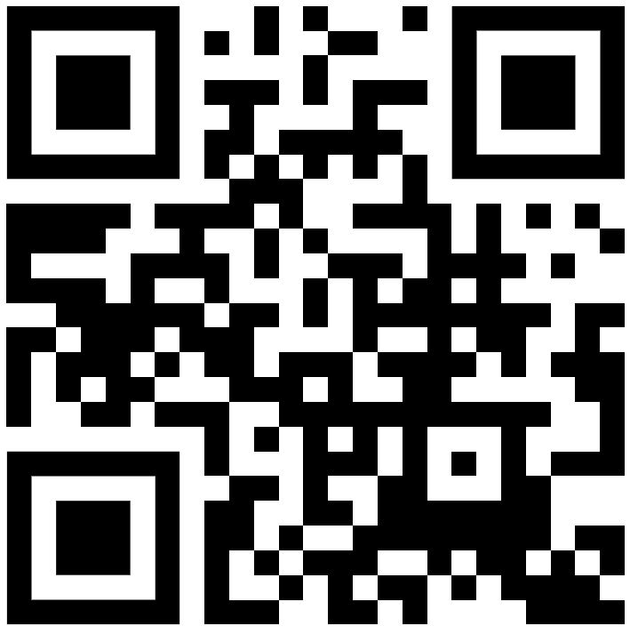
Choose Ohio First Scholarships cscc.edu/cof
Information Technology
Engineering Technology
Nursing
Allied Health
Welding
Associate of Science

